Slide 1
Station: Lat: Long:
J | F | M | A | M | J | J | A | S | O | N | D
Rainfall mm
Temperature 0 ⁰
West
VE :
SCALE
1:
1cm: m
A Lat :
Long:
Landform
Population
Climate
Vegetation
Landuse
Sheet 1

Slide 2
USA Continental
Scale 1:
1 cm : km
Sheet 2

Slide 3
Cross – Section and Transect
Station: Lat: Long:
J | F | M | A | M | J | J | A | S | O | N | D
Rainfall mm
Temperature 0 ⁰
Sheet 3

Slide 4
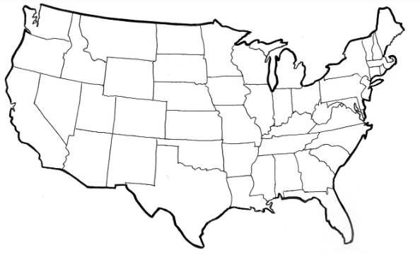
Name:
Teacher:
East
https://lakeviewcampgroundwi.com/maps_rm.php
km
B Lat :
Long:
 | Elevation | Distance from Start
Point A | 0 metres | 0
1
2
3
4
5
6
7
8
9
10
11
12
13
14
15
Bibliography
Sheet 4

